Slide 1
4th Grade Curriculum Night
Anna Cajiga
Amy Sheridan
Lisa Shainker
Larry Thomas
Heather Harris
Ashley Jones
Denine Rowley

Slide 2
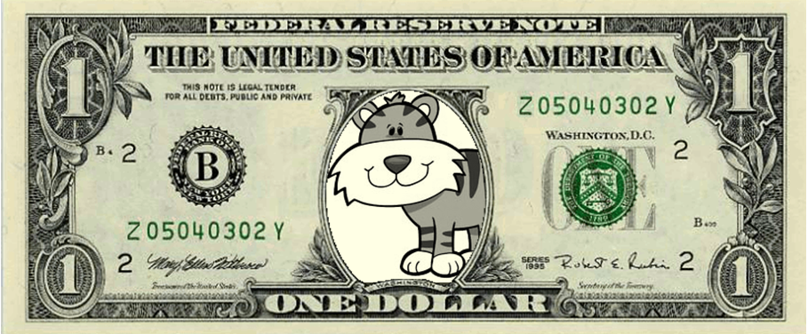
Expectations
Student Behavior Report (SBR)
  Teacher initials indicate a behavior expectation that is NOT being met
  Allows us to look for patterns
  Initial SBR each Day, return to school on Monday
Behavior Bucks
  Receive Behavior Bucks for having a signed SBR
  Receive Bucks throughout day for making good choices
Class auction
  One auction per month
  We are looking for donations for our auctions!
Homework
  40 – 50 minutes each night

Slide 3
Organization
Binders
  Section for each content area (Reading, LA, Math, SS/Sci, HW)
  Modeling organization!
  No loose papers
  Random binder checks
Agendas
  Homework recorded daily
  Random agenda checks
ALWAYS check binders on Fridays!
  Any papers from school sent in Friday Folders
  Signed papers due by Wednesday with a parent signature
    Each teacher will send a set of signed papers

Slide 4
Grading
Grade Weighting
  50% - Tests, Performance Assessments, In-School Projects, End of Unit Writing
  20% - Quizzes, Home Projects, Oral Presentations
  20% - Classwork
  10% - Homework
E-School Plus
  Check grades online
70/30 Tests
  KEEP STUDY GUIDES!!
Testing for Mastery
  If student does not pass a test, they have an opportunity to retest for a recovery grade of 70%

Slide 5
AAA
(Additional Academic Activities)
7:15 – 7:40am
Begins Tuesday, September 4th
Schedule
  Sheridan – 4 days of Writing
  Shainker & Thomas– 2 days of 4th grade Math and 3 days of 5th grade Math
  Bilyeu – 4 days of Science/Social Studies, with Reading integrated
  Sanders & Jones – 4 days of Reading/Writing & Math
Friday – Retests
Look for letters home with signed papers or notes in agenda

Slide 6
Reading
Read and understand texts from many genres
  Fiction, nonfiction, poetry, drama
Monitor understanding while reading – literary texts AND informational texts
Use context clues to find meaning of words
Root words, prefixes, suffixes
Read fluently – Read together at home!!
Identify themes in literature
Discuss texts
  Communicate ideas effectively
  Ask questions
  Make judgments and support them with evidence
Explain how authors use different techniques
  Sensory details, figurative language, foreshadowing, etc.
Recognize organizational structures
  Cause and effect, chronological order, etc.
Accelerated Reader – Read at least 25 books!

Slide 7
Language Arts
Write in several genres
  Narrative, opinion, informational, response to literature
Research and find information
Ideas
  Maintain focus in writing
Organization
Style
  Engage reader
  Show evidence of the author’s craft in writing
Conventions
  Complete sentences
  Parts of speech
  Mechanics
Edit and revise writing
Use writing as a tool for learning

Slide 8
Social Studies
Early Native American cultures
European exploration of North America
British colonial America
American Revolution
New American nation
Westward expansion
Abolitionist and suffrage movements
Natural and man-made geographical features in the U.S.
  Locate, describe how they affected the growth of the U.S.
Historical documents
Democratic beliefs and freedoms
Economic concepts, how they relate to historic events

Slide 9
Science
Scientific Method
  Differentiate between observations and ideas
  Use tables or graphs to identify patterns of change
Stars and planets
Earth, Moon and Sun
Water cycle
Weather
Light and Sound
Force and Motion
Simple Machines
Food chains in ecosystems
Survival, extinction, adaptations

Slide 10
Math
Use four arithmetic operations to solve and check problems
Determine when and how to use rounding
Multiplication and division of whole numbers (2-3 digits by 1-2 digits)
Add and subtract simple decimals and common fractions with common denominators
Use appropriate units and tools to measure angles and weight
Understand geometric plane and solid figures
Coordinate system
Use different strategies to solve problems
  Ex. Working backwards
Write mathematical expressions using symbols
Bar, line, and picture graphs

Slide 11
Questions???

